Slide 1



Noida Institute of Engineering and Technology, Greater Noida
Multiple Access Techniques for Mobile Communication
Unit: 4
Wireless Communication (AOE 0772)
Mr. Rishi Singhal
EN
Department
B. Tech 7th Sem (4th year)

Slide 2
WIRELESS COMMUNICATION
Course Contents / Syllabus
Introduction of Wireless Communication
History and evolution of mobile radio systems, General Model of Wireless Communication Link, Types of mobile wireless services/systems-Cellular, WLL, Paging, Satellite Systems, Future trends in personal wireless systems.
Cellular Concepts and System Design Fundamentals
Cellular Infrastructure, Cellular System Components, Antennas for Cellular Systems, Operation of Cellular Systems, frequency reuse, channel assignment, handoff strategies, Interference and system capacity.
Mobile Radio Propagation Models
Radio wave propagation issues in personal wireless systems, Propagation models, Channel Noise and Losses, Fading in Land Mobile Systems, Multipath Fading, Fading Effects on Signal and Frequency, Shadowing; Wireless Channel Modeling: AWGN Channel, Rayleigh Channel,
Equalization, Diversity Techniques & Multiple Access Techniques
Equalization, Rake receiver concepts, Diversity Techniques, Linear predictive coders and channel coding. Multiplexing and Multiple Access: FDMA, TDMA, CDMA, OFDMA, Multiple Access for Radio Packet Systems: Pure ALOHA, Slotted ALOHA, CSMA and their versions; Packet and Pooling Reservation Based Multiple Access Schemes.
Wireless Systems & Standards
GSM system for mobile Telecommunication, General Packet Radio Service, Edge Technology; CDMA 2000, IMT 2000 and UMTS, Long Term Evolution (LTE), Introduction to Mobile Adhoc Networks, Li-Fi Communication, Ultra-Wideband Communication, Mobile data networks, Introduction to 4G, 5G and concept of NGN.

Slide 3
WIRELESS COMMUNICATION
Text Books:
T.S. Rappaport, “Wireless Communication-Principles and practice”, Pearson Publications, Second Edition.
2. Upena Dalal, “Wireless Communication and Networks”, Oxford Press Publications.
3. T L Singal ,“Wireless Communications ”, McGraw Hill Publications.
Reference Books:
1. Andrea Goldsmith, “Wireless Communications”, Cambridge University Press.
2. S. Haykin & M. Moher, “Modern wireless communication”, Pearson, 2005.
NPTEL/ YouTube/ Faculty Video Link:
Unit 1
https://youtu.be/JCGMP37-2EA
Unit 2
https://youtu.be/f2wlHL1Sok8
https://youtu.be/0PWILK-hqbQ
Unit 3
https://youtu.be/SFcRtZ30rqs
https://youtu.be/BKf2mN9W6Nk
https://youtu.be/tePZhxRLsjE
Unit 4
https://youtu.be/GLmF3YB0pQU
https://youtu.be/QHqZwBoTJRY
Unit 5
https://youtu.be/t3FVP5wuG4g
https://youtu.be/ixY0Cau4mBM

Slide 4
Content
Introduction
Equalization
RAKE Receiver concepts
Diversity Techniques
Linear predictive coders and channel coding
Multiplexing
Multiple Access Techniques
FDMA
TDMA
CDMA
OFDMA
OFDMA
SC-FDMA
Multiple Access for Radio Packet System
Pure ALOHA
Slotted ALOHA
CSMA and their versions
Packet and Pooling Reservation Based Multiple Access Schemes.

Slide 5
Objective of Unit
To make students familiar with fundamentals of mobile communication systems.
To choose system (TDMA/FDMA/CDMA) according to the complexity, installation cost, speed of transmission, channel properties etc.

Slide 6
Course Outcome
Familiarize with various generations of mobile communications.
Understand the concept of cellular communication.
Understand the channel modeling of wireless communication.
Understand the various spread spectrum modulation, diversity combining and equalization techniques.
Gain knowledge of IS-95 CDMA and GSM mobile communication standard, its architecture, logical channels, advantages and limitations.
Understand the different multiple access techniques of wireless mobile communication.

Slide 7
CO-PO and PSO Mapping
Mapping of Course Outcomes and Program Outcomes:
S. No. | Course Outcome | PO1 | PO2 | PO3 | PO4 | PO5 | PO6 | PO7 | PO8 | PO9 | PO10 | PO11 | PO12
1 | REC-085.1 | 2 | 2 | 1 | 1 | 2 | 2 | 2 | 2 | 2 | 2 | 1 | 3
2 | REC-085.2 | 2 | 2 | 2 | 2 | 1 | 2 | 2 | 2 | 2 | 3 | 1 | 2
3 | REC-085.3 | 3 | 1 | 2 | 1 | 2 | 2 | 1 | 1 | 2 | 3 | 2 | 2
4 | REC-085.4 | 3 | 1 | 1 | 1 | 3 | 3 | 2 | 1 | 1 | 3 | 1 | 2
5 | REC-085.5 | 2 | 1 | 2 | 2 | 3 | 3 | 2 | 1 | 2 | 3 | 2 | 2
6 | REC-085.6 | 3 | 2 | 2 | 2 | 2 | 3 | 2 | 1 | 2 | 3 | 1 | 2

Slide 8
CO-PO and PSO Mapping
Mapping of Program Specific Outcomes and Course Outcomes:
S.No | Course Outcome | PSO1 | PSO2 | PSO3
1 | REC-085.1 | 3 | 2 | 1
2 | REC-085.2 | 3 | 3 | 1
3 | REC-085.3 | 3 | 3 | 1
4 | REC-085.4 | 2 | 2 | 1
5 | REC-085.5 | 3 | 3 | 1
6 | REC-085.6 | 3 | 3 | 1
 | Average | 2.83 | 2.66 | 1

Slide 9
Prerequisite and Recap
Basic knowledge of multiplexing.
Basic knowledge of random access method.

Slide 10
Equalization
Equalization refers to the process of adjusting the balance between different frequency components within an audio signal or across other types of signals, such as in the context of image processing. The goal of equalization is to enhance or modify the spectral characteristics of the signal to achieve a desired sound or visual quality.
In audio, equalization is commonly used to:
Correct for room acoustics: In live sound and recording, equalization can be used to compensate for the acoustic properties of a room or venue, helping to achieve a more balanced and pleasing sound.
Enhance tonal quality: Equalization allows for the adjustment of the bass (low-frequency) and treble (high-frequency) components of a sound to achieve a particular timbre or tonal balance.
Eliminate feedback: In live sound reinforcement, equalization can be used to prevent or mitigate feedback by reducing the level of specific frequency bands that are prone to causing feedback.
Remove unwanted noise: Equalization can be used to reduce or eliminate unwanted background noise or interference by attenuating specific frequencies.

Slide 11
Equalization
Equalization
Equalization is typically achieved using equalizers, which are audio processing devices or software tools that allow you to adjust the gain or attenuation of specific frequency bands within an audio signal. There are various types of equalizers, including graphic equalizers, parametric equalizers, shelving equalizers, and more, each with its own set of controls and capabilities.
Equalization can be applied in both analog and digital audio processing, and it plays a crucial role in shaping the sound in various audio applications, such as music production, live sound reinforcement, broadcasting, and more. It can also be used in other fields, like image processing, where it involves adjusting the intensity of different color components to achieve desired visual effects or corrections.

Slide 12
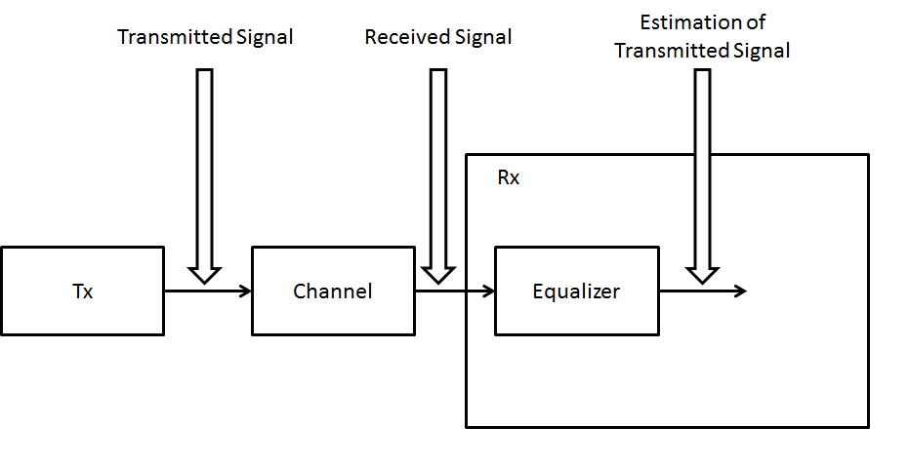
Equalization
Design of equalizer for wireless communication

Slide 13
RAKE Receiver concepts
A RAKE receiver is a type of receiver used in wireless communication systems, particularly in CDMA (Code Division Multiple Access) and spread spectrum communication systems. The RAKE receiver is designed to mitigate the effects of multipath interference and enhance signal reception in scenarios where signals take multiple paths to reach the receiver due to reflections and other propagation phenomena.
Here are some key concepts associated with RAKE receivers:
Multipath Propagation: In wireless communication, signals often encounter multiple paths as they travel from the transmitter to the receiver. These paths may involve direct line-of-sight (LOS) propagation as well as reflections and scattering. The multiple paths can lead to signal delay and phase variations, causing interference at the receiver.
Finger Elements: The RAKE receiver uses multiple "fingers" or "taps" to capture and process the different components of the received signal that have taken different paths. Each finger corresponds to a distinct time-delayed version of the transmitted signal. These fingers help in separately receiving and processing the multipath components.

Slide 14
RAKE Receiver concepts
3.Combining and Equalization: Each finger of the RAKE receiver is responsible for capturing a specific multipath component. The receiver then combines these components coherently to reconstruct the original signal. Equalization techniques may be applied to each finger to account for phase and amplitude variations introduced by the multipath channels.
4. Delay Profile: The RAKE receiver often utilizes a delay profile or tap delay profile to determine the time delays and strengths of the multipath components. This information is essential for the receiver to align and combine the received signals effectively.
5. Delay Profile: The RAKE receiver often utilizes a delay profile or tap delay profile to determine the time delays and strengths of the multipath components. This information is essential for the receiver to align and combine the received signals effectively.
6. Maximal Ratio Combining (MRC): Maximal Ratio Combining is a common technique used in RAKE receivers to combine the multipath components optimally. MRC adjusts the weighting of each finger to maximize the signal-to-noise ratio (SNR) and improve signal quality.

Slide 15
RAKE Receiver concepts
7. RAKE Fading Channels: RAKE receivers are particularly effective in combating fading channels, where the received signal experiences rapid variations in amplitude and phase. The diversity gained from multiple fingers helps mitigate the impact of fading.
8. CDMA and Spread Spectrum: RAKE receivers are frequently used in CDMA systems, where different users transmit simultaneously using the same frequency band, distinguished by unique codes. The multipath interference in CDMA systems can be effectively mitigated by RAKE receivers.
9. Interference Rejection: RAKE receivers are also capable of rejecting interference from other users (i.e., users with different codes) in CDMA systems by exploiting the orthogonal properties of the spreading codes.
In summary, a RAKE receiver is a key component in CDMA and spread spectrum communication systems that addresses the challenges posed by multipath propagation, delay, and phase variations. By employing multiple fingers to capture and process the different multipath components, a RAKE receiver can effectively reconstruct the original signal and improve the overall quality of received communications.

Slide 16
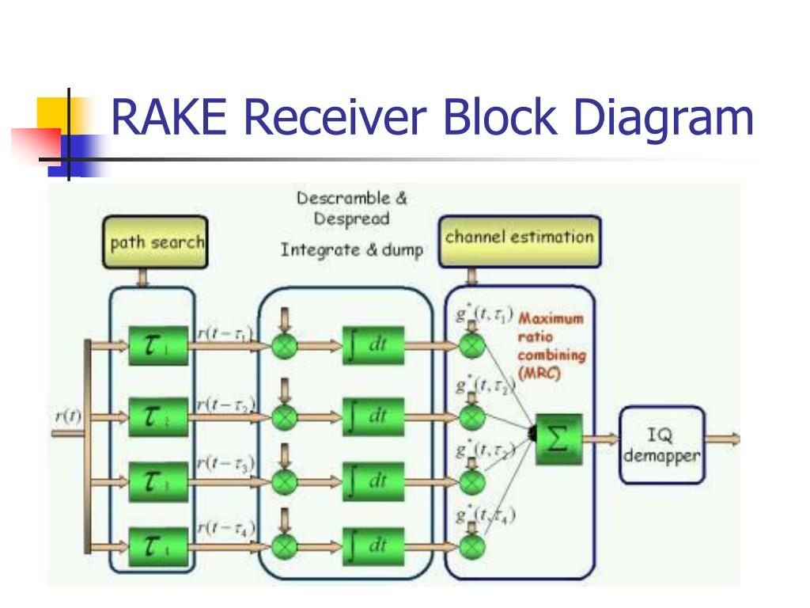
RAKE Receiver concepts

Slide 17
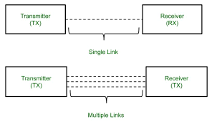
Diversity Techniques
Diversity is mainly used in radio communication and is a common technique for combatting fading and co-channel interference and avoiding error bursts. It is based on the fact that individual channels experience fades and interference at different, random times, i.e, they are at least partly independent.

Slide 18
Diversity Techniques
Diversity techniques in wireless communication are methods used to combat the negative effects of signal fading and interference in wireless channels. These techniques enhance the reliability and quality of wireless communication by improving the robustness of signal reception. There are several diversity techniques employed in wireless communication systems:
Antenna Diversity: In antenna diversity,Multiple Antennas (MIMO): Multiple Input Multiple Output technology uses multiple transmit and receive antennas to improve signal quality. Various techniques like Alamouti coding and V-BLAST are used to exploit spatial diversity.
Time Diversity: Time Diversity Combining: Reception of the same signal at multiple time instances can help mitigate fading and improve signal quality. This is commonly used in slow-fading environments.

Slide 19
Diversity Techniques
3.Frequency Diversity: Frequency-Hopping Spread Spectrum: Spread the signal across multiple frequencies to reduce the impact of narrowband interference or fading at specific frequencies.
4. Polarization Diversity: Use of antennas with different polarization orientations to reduce signal fading due to changes in polarization of the transmitted signal in the wireless channel.
5.Selection Diversity: Choose the best signal among multiple received signals. This can be done using techniques like maximal ratio combining, where the receiver selects the signal with the highest SNR (Signal-to-Noise Ratio).
6. Switched Diversity: Select the best antenna, frequency, or time instance based on feedback from the receiver or using an adaptive algorithm. Switching is done dynamically to improve link quality.
7.Space-Time Coding: Combine spatial and temporal diversity by encoding data across multiple antennas and over multiple time instances. Techniques like Alamouti coding and space-time trellis coding are used to take advantage of both spatial and time diversity.
8.Cooperative Diversity: Involves cooperation among different wireless devices or nodes to relay signals to extend wireless coverage and improve reliability. Relaying can be done using amplify-and-forward or decode-and-forward techniques.

Slide 20
Diversity Techniques
9. Diversity Combining: Combine multiple received signals to improve the overall signal quality. This can be done through techniques like equal gain combining, maximal ratio combining, and selection combining.
10.Hybrid Beamforming: Utilize a combination of analog and digital beamforming to focus signal energy in specific directions, reducing interference and improving signal quality.
11.Interference Rejection Techniques: Use techniques like spatial filtering and beamforming to reduce interference from other sources and focus on the desired signal.
12. Adaptive Modulation and Coding (AMC): Adjust the modulation and coding schemes dynamically based on the channel conditions to maintain a reliable link.

Slide 21
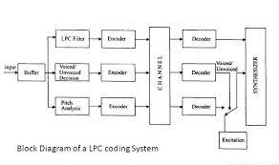
Linear predictive coders
Linear Predictive Coding (LPC) is a widely used technique in speech and audio signal processing for the compression and analysis of speech signals. LPC is a method that models the spectral envelope of a speech signal by analyzing its short-term properties. It's commonly used in speech coding, speech recognition, and other audio processing applications.

Slide 22
Linear predictive coders
Here's how LPC works:
Frame Segmentation: The input speech signal is divided into short overlapping frames, typically 20-30 milliseconds in duration. Each frame is assumed to be stationary, which means that the properties of the signal within that frame remain relatively constant.
2. Windowing: Each frame is multiplied by a window function (e.g., Hamming window) to reduce spectral leakage and create smooth transitions at the frame boundaries.
3. Autocorrelation Analysis: LPC starts by computing the autocorrelation of the speech signal within each frame. The autocorrelation function measures the similarity between the signal and time-shifted versions of itself. This function helps in estimating the linear predictive coefficients.
4. Levinson-Durbin Algorithm: The autocorrelation coefficients are then used as input to the Levinson-Durbin algorithm, which is an efficient method for finding the LPC coefficients. The algorithm recursively computes a set of filter coefficients that minimize the mean square error between the original signal and the predicted signal.

Slide 23
Linear predictive coders
5.Residual Signal: The LPC coefficients describe a linear predictive model of the speech frame. The difference between the actual frame and the predicted frame is called the residual signal, representing the spectral details of the speech signal.
6. Spectral Envelope: The LPC coefficients can be interpreted as a model of the spectral envelope of the speech signal. This envelope can be used for various purposes, such as speech synthesis, noise reduction, and speaker recognition.
7. Quantization and Encoding: To compress the speech signal, the LPC coefficients and residual signal are quantized and encoded into a more compact representation, reducing the amount of data needed to represent the speech signal.
Linear Predictive Coding is an important component of many speech and audio compression standards, such as the Code-Excited Linear Prediction (CELP) used in various speech codecs. It also plays a role in speech recognition by modeling the vocal tract characteristics of speech sounds, helping in the recognition of spoken words and phrase.

Slide 24
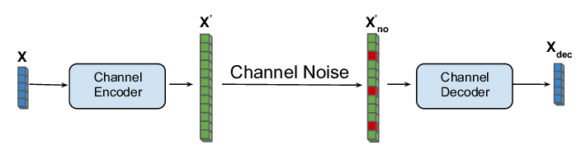
channel coding
"In the transmitter, before a message is sent, it's encoded. Then in the receiver, it can be decoded to recover the original message and remove all of the noise, interference and effects of poor signal strength. This is called Channel Coding.“
When performing source coding one aims to remove all redundancy in the source data, for channel coding the opposite is done; redundancy is introduced into the data in order to protect the data against channel errors. These channel errors can for instance be packet losses, considered in Papers A, B and D, or bit errors considered in Paper C. In the nonideality of the channel is modelled as discrete memoryless disturbance, p(j|i), when transmitting the index i and receiving index j. Note that j is not necessarily equal to i. Channel coding tries to protect the system against these kinds of imperfections.

Slide 25
channel coding
p(j|i) j Xˆ i X Encoder Decoder Figure Model of transmission over a channel. There exist theoretical formulas for how much information that, in theory, can be transmitted over a channel with certain statistics. This value is called capacity and tells us the maximum number of bits per channel use that can be transmitted over the channel such that an arbitrary low error probability can be achieved. It should be noted that the capacity is a supremum which it not necessarily archive- able itself, this will depend on the channel statistics. For stationary and memoryless channels, the capacity is
C = max p(x) I(X; Y )
which is the well-known formula for capacity originating from Shannon’s groundbreaking . X and Y are not required to be discrete in this formula but generally when dealing with continuous alphabets a constraint on p(x) in (22) is introduced such that the power is restricted, i.e. p(x) : E[X2 ] ≤ P. Furthermore, if the channel has memory Dobrushin [12] derived the capacity for “information stable channels” (see e.g. [13] for explanation) and Verdu and Han [14] showed a ´ general formula valid for any channel.

Slide 26
Multiplexing
Multiplexing is a fundamental concept in telecommunications and data transmission that allows multiple signals or data streams to share a common transmission medium, such as a cable, fiber-optic line, or wireless channel. The main purpose of multiplexing is to make efficient use of the available bandwidth or resources while ensuring that the various signals can be transmitted and received simultaneously without significant interference or data loss. Multiplexing techniques are commonly used in telecommunication systems, computer networks, and broadcasting.
There are several methods of multiplexing, each designed for different types of applications and communication scenarios. The most common types of multiplexing include:

Slide 27
Multiplexing
3. Wavelength Division Multiplexing (WDM): WDM is similar to FDM but is specifically used in optical fiber communication. It assigns different wavelengths of light to various signals, allowing multiple data streams to be sent simultaneously over a single optical fiber.
4. Code Division Multiplexing (CDM): CDM assigns a unique code to each signal and allows them to be transmitted simultaneously on the same frequency or time slot. This method is commonly used in CDMA (Code Division Multiple Access) cellular networks.
5. Statistical Multiplexing: This method allocates bandwidth dynamically based on the needs of different data streams. It is commonly used in computer networks, where data packets are transmitted as they become available, with no fixed time or frequency allocations.
6. Space Division Multiplexing (SDM): SDM involves using multiple physical paths or channels to transmit data. In wireless communication, this might involve using multiple antennas (MIMO - Multiple-Input, Multiple-Output) to transmit multiple data streams over the same radio channel.
Multiplexing plays a crucial role in optimizing the use of resources and ensuring efficient communication in various contexts. It allows for the simultaneous transmission of voice, data, video, and other forms of information on the same network or medium. Demultiplexing is the process of separating the multiplexed signals back into their original individual streams at the receiver's end, using the appropriate demultiplexing technique corresponding to the multiplexing method used.

Slide 28
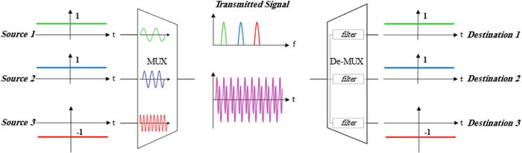
Multiplexing

Slide 29
Introduction Multiple Access
Many users at same time
Share a finite amount of radio spectrum
High performance
Duplexing generally required
Frequency domain
Time domain

Slide 30
Frequency Division Duplexing (FDD)
two bands of frequencies for every user
forward band
reverse band
duplexer needed
frequency seperation between forward band and reverse band is constant
 | reverse channel |  | forward channel
frequency seperation
f

Slide 31
Time Division Duplexing (TDD)
Uses time for forward and reverse link
Multiple users share a single radio channel
Forward time slot
Reverse time slot
No duplexer is required
 | reverse channel |  | forward channel
t
time seperation

Slide 32
Multiple Access Techniques
Frequency division multiple access (FDMA)
Time division multiple access (TDMA)
Code division multiple access (CDMA)
Space division multiple access (SDMA)
grouped as:
narrowband systems
wideband systems

Slide 33
Narrowband Systems
large number of narrowband channels usually FDD
Narrowband FDMA
Narrowband TDMA
FDMA/FDD
FDMA/TDD
TDMA/FDD
TDMA/TDD

Slide 34
Logical separation FDMA/FDD
FDMA/FDD
user 1 | forward channel
 | reverse channel
...
user n | forward channel
 | reverse channel
f
t

Slide 35
Logical separation FDMA/TDD
FDMA/TDD
user 1
forward channel | reverse channel
...
user n
forward channel | reverse channel
f
t

Slide 36
Logical separation TDMA/FDD
TDMA/FDD
user 1 | forward channel | ... | user n | forward channel
 | reverse channel |  |  | reverse channel
f
t

Slide 37
Logical separation TDMA/TDD
TDMA/TDD
user 1 |  | ... | user n
forward channel | reverse channel |  | forward channel | reverse channel
f
t

Slide 38
Wideband Systems
large number of transmitters on one channel
TDMA techniques
CDMA techniques
FDD or TDD multiplexing techniques
TDMA/FDD
TDMA/TDD
CDMA/FDD
CDMA/TDD

Slide 39
Logical separation CDMA/FDD
CDMA/FDD
user 1
forward channel | reverse channel
...
user n
forward channel | reverse channel
code
f

Slide 40
Logical separation CDMA/TDD
CDMA/TDD
user 1
forward channel | reverse channel
...
user n
forward channel | reverse channel
code
t

Slide 41
Applications
Multiple Access Techniques in use
Multiple Access Cellular System
Technique
Advanced Mobile Phone System (AMPS) Global System for Mobile (GSM)
US Digital Cellular (USDC)
FDMA/FDD TDMA/FDD TDMA/FDD
Digital European Cordless Telephone (DECT) FDMA/TDD US Narrowband Spread Spectrum (IS-95) CDMA/FDD

Slide 42
Frequency Division Multiple Access FDMA
One phone circuit per channel
Idle time causes wasting of resources
Simultaneously and continuously transmitting
Usually implemented in narrowband systems
For example: in AMPS is a FDMA bandwidth of 30 khz implemented

Slide 43
FDMA compared to TDMA
Frequency Division Multiple Access FDMA
Fewer bits for synchronization
Fewer bits for framing
Higher cell site system costs
Higher costs for duplexer used in base station and subscriber units
FDMA requires RF filtering to minimize adjacent channel interference

Slide 44
Time Division Multiple Access
Time Division Multiple Access TDMA
Time slots
One user per slot
Buffer and burst method
Non-continuous transmission
Digital data
Digital modulation

Slide 45
Features of TDMA
Time Division Multiple Access TDMA
A single carrier frequency for several users
Transmission in bursts
Low battery consumption
Handoff process much simpler
FDD : switch instead of duplexer
Very high transmission rate
High synchronization overhead
Guard slots necessary

Slide 46
Space Division Multiple Access SDMA
Controls radiated energy for each user in space using spot beam antennas.
Base station tracks user when moving
Cover areas with same frequency: TDMA or CDMA systems
Cover areas with same frequency: FDMA systems

Slide 47
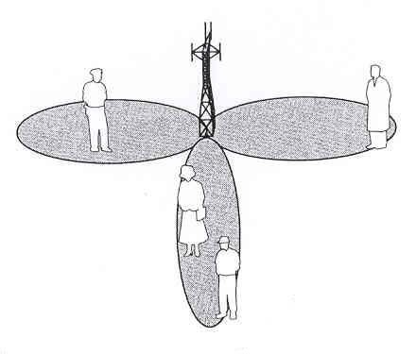
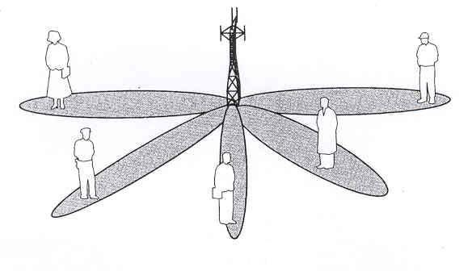
Space Division Multiple Access SDMA
Primitive applications are “sectorized antennas”
In future adaptive antennas simultaneously steer energy in the direction of many users at once

Slide 48
Disadvantage of SDMA
Space Division Multiple Access SDMA
Perfect adaptive antenna system: infinitely large antenna needed
Compromise needed

Slide 49
Orthogonal Frequency Division Multiple Access (OFDMA)
The technique used for radio transmission and reception in LTE
Carries out the same functions as any other multiple access technique, by allowing the BS to communicate with several different mobiles at the same time.
A powerful way to minimize the problems of fading and inter-symbol interference.

Slide 50
Orthogonal Frequency Division Multiple Access (OFDMA)
OFDMA is used by several other radio communication systems.
IEEE 802.11 versions a, g and n
WiMAX (IEEE 802.16)
Digital television
Radio broadcasting
Orthogonal Frequency Division Multiplexing
1.1 Reduction of Inter-Symbol Interference using OFDM
1.2 The OFDM Transmitter
1.3 Initial Block Diagram

Slide 51
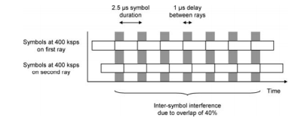
Reduction of Inter-Symbol Interference using OFDM
• High data rate transmission in a multipath environment leads to Inter Symbol Interference (ISI).
Example, the delay spread was 1μs and the data rate was 400 ksps, so the symbols overlapped at the receiver by 40%.
This led to interference and bit errors at the receiver.
OFDM is a powerful way to solve the problem.

Slide 52
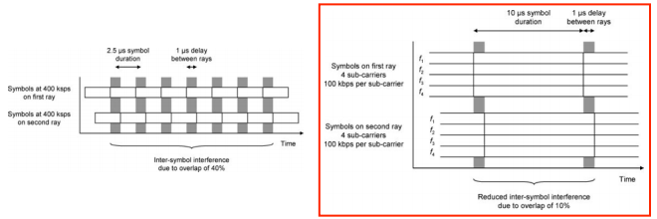
OFDM Transmitter
Divides the information into several parallel sub-streams.
Sends each sub-stream on a different frequency (sub-carrier)
‣ If the total data rate stays the same, then - The data rate on each sub-carrier is less than before, so the symbol duration is longer.
‣ This reduces the amount of ISI, and reduces the error rate.

Slide 53
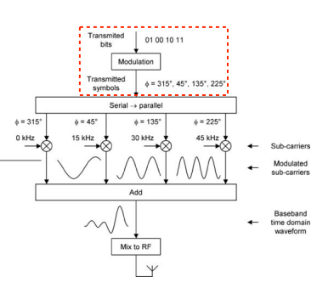
OFDM Transmitter
It is a block diagram of an analogue OFDM transmitter .
Transmitter
Accepts a stream of bits from higher layer protocols, and
Converts them to symbols using the chosen modulation scheme, for example quadrature phase shift keying (QPSK).

Slide 54
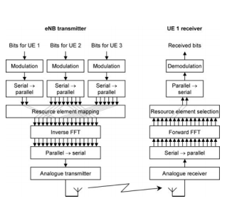
Initial Block Diagram
Figure is a block diagram of an OFDM transmitter and receiver
Assume that the system is operating on the downlink, so that the transmitter is in the BS and the receiver is in the mobile

Slide 55
Single Carrier Frequency Division Multiple Access
SC-FDMA
The power variations described above arise because there is a one-to-one mapping between symbols and sub-carriers.
If we mixed the symbols together before placing them on the sub-carriers, then we might be able to adjust the transmitted signal and reduce its power variations.
For example, when transmitting two symbols x1 and x2 on two sub-carriers, we might send their sum x1 + x2 on one sub-carrier, and their difference x1 − x2 on the other.

Slide 56
Single Carrier Frequency Division Multiple Access
SC-FDMA
We can use any mixing operation at all, as the receiver can reverse it: we just need to find one that minimizes the power variations in the transmitted signal.
It turns out that a suitable mixing operation is another FFT, this time a forward FFT.
By including this operation, we arrive at a technique known as single carrier frequency division multiple access (SC-FDMA).

Slide 57
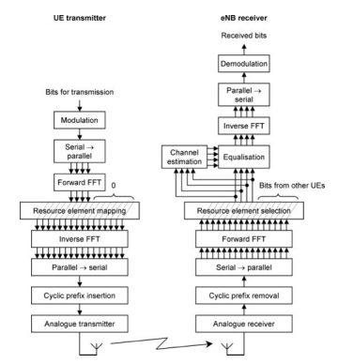
Block Diagram of an SC-FDMA Transmitter and Receiver

Slide 58
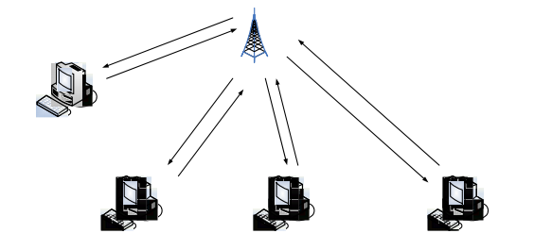
ALOHA (pure ALOHA or unslotted ALOHA)
It was developed at the University of Hawaii in the early 1970s to connect computers situated on different Hawaiian islands.
The computers of the ALOHA network transmit on the same radio channel whenever they have a packet to transmit.
ALOHA is the father of multiple access protocols.

Slide 59
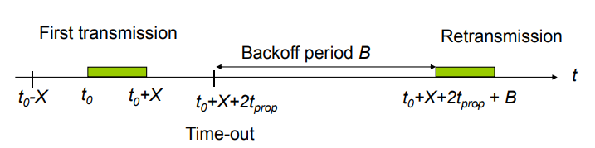
ALOHA protocol
A user transmits whenever it has data to transmit.
If more than one frames are transmitted, they interfere with each other (collide) and are lost.
If ACK not received within timeout, then a user picks random back-off time (to avoid repeated collision).
User retransmits frame after back-off time.

Slide 60
ALOHA protocol
Definitions and assumptions –
X: frame transmission time (assume constant)
S: throughput (average # successful frame transmissions per X seconds)
G: load (average # transmission attempts per X sec.)
Psuccess : probability a frame transmission is successful.
S = G*Psuccess

Slide 61
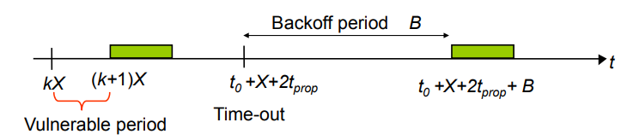
Slotted ALOHA
Protocol
Time is slotted in X seconds slots
Users synchronized to frame times
Users transmit frames in first slot after frame arrival
Backoff intervals in multiples of slots

Slide 62
Example: ALOHA and Slotted ALOHA
Suppose that a radio system uses a 9600 bps channels for sending call setup request messages to a base station. Suppose that packets are 120 bits long. What is the maximum throughput possible with ALOHA and with slotted ALOHA?
The system transmits packets at a rate
= (9600 bits/second) x (1 packet/120bits)
= 80 packets/second.
The maximum throughput for ALOHA
= 80 x (0.184) ≈ 15 packets/second
The maximum throughput for slotted ALOHA
= 80 x (0.368) ≈ 30 packets/second

Slide 63
Carrier Sense Multiple Access (CSMA)
Protocol
A station senses the channel (by checking for a voltage) before it starts transmission
If busy, either wait or schedule backoff (different options).
If idle (no voltage sensed), start transmission.
When collisions occur they involve entire frame transmission times.
Vulnerable period is reduced to tprop

Slide 64
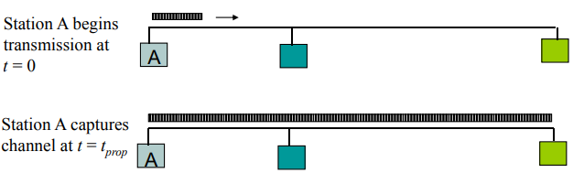
Carrier Sense Multiple Access (CSMA)
If tprop > X (or if a = tprop/X > 1), no gain compared to ALOHA or slotted ALOHA.

Slide 65

Carrier Sense Multiple Access (CSMA)
CSMA options differ when a station has a frame to transmit but the channel is busy.
1-persistent CSMA (most greedy)
Start transmission as soon as the channel becomes idle.
Low delay and low efficiency
Non-persistent CSMA (least greedy)
Wait a backoff period, then sense carrier again.
High delay and high efficiency.
p-persistent CSMA (adjustable greedy)
Wait till channel becomes idle, transmit with prob. p; or wait one tprop time & re-sense with probability 1-p
Delay and efficiency can be balanced

Slide 66
Carrier Sense Multiple Access with Collision Detection (CSMA/CD)
Protocol
In CSMA/CD protocol, nodes with packets to transmit must sense the channel and proceed as follow:
If the channel is idle, transmit and listen while transmitting
If the channel is busy (similar to CSMA) persist, backoff immediately, or persist and attempt transmission with probability p.
In case of a collision, a node transmits a short jamming signal so that other nodes know there is a collision and abort the transmission. Then, the backoff algorithm is used to schedule a future re-sensing time.
• In CSMA, collisions result in wastage of X seconds spent in transmitting an entire frame
• CSMA/CD reduces the wastage of time by aborting the transmission after detecting the collision
• CSMA/CD scheme provides the basis for the Ethernet LAN protocol

Slide 67
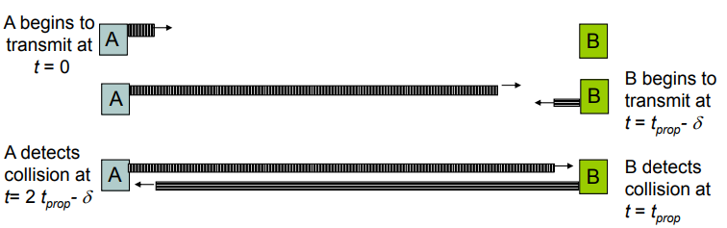
Carrier Sense Multiple Access with Collision Detection (CSMA/CD)
CSMA/CD reaction time
It takes 2 tprop to find out if channel has been captured

Slide 68
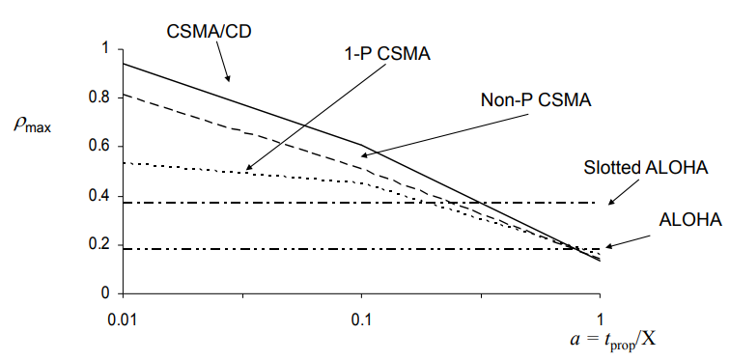
Maximum Achievable Throughputs of Random Access MAC Techniques
For small a: CSMA-CD has best throughput.
For larger a: Aloha & slotted Aloha better throughput

Slide 69
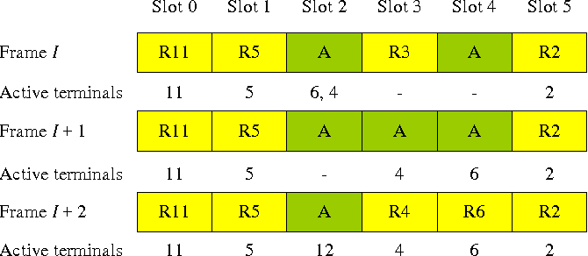
Packet and Pooling Reservation Based Multiple Access Schemes.
Packet reservation multiple access (PRMA) is a transmission protocol proposed for packet voice terminals in a cellular system. PRMA is a time division multiplex (TDM) based multiple access protocol that allows a group of spatially dispersed terminals to transmit packet voice and low, bit rate data over a common channel.

Slide 70
Packet and Pooling Reservation Based Multiple Access Schemes.
Multiple Access Schemes:
Multiple Access Schemes are methods that allow multiple users to share a common communication channel efficiently.
Examples include Time Division Multiple Access (TDMA), Frequency Division Multiple Access (FDMA), Code Division Multiple Access (CDMA), and Orthogonal Frequency Division Multiple Access (OFDMA).
Packet Reservation:
Packet reservation typically refers to a mechanism where a certain portion of the communication channel is reserved for the transmission of specific packets or data.
This can be a part of a broader access scheme to prioritize or allocate resources for specific types of data.
Pooling Reservation:
Pooling in a communication context often involves grouping resources together for more efficient utilization.
Pooling reservation could imply reserving a pool of resources for specific purposes or users.

Slide 71
Toping mapping with course outcome
S. No. | Topic | Course Outcome
1 | Multiple access techniques and schemes | CO6

Slide 72
Faculty Video Links, Youtube & NPTEL Video Links and Online Courses Details
Youtube/other Video Links
https://www.youtube.com/watch?v=QE-GmtXIKGs
https://www.youtube.com/watch?v=veoHyi3OUco
https://www.youtube.com/watch?v=sx0UPzztC5o

Slide 73
Daily Quiz
Multiple access schemes are used to allow ____ mobile users to share simultaneously a finite amount of radio spectrum. a) Many b) One c) Two d) Ten-Fifteen
The technique that makes possible the task of listening and talking in communication system is called ________ a) Simplexing b) Duplexing c) Modulating d) Multiple access technique
Time division duplexing uses ____ to provide both a forward and reverse link. a) Frequency b) Time c) Time and frequency d) Cell spacing

Slide 74
Daily Quiz
4. The symbol time in FDMA systems is _________ thus intersymbol interference is ______ a) Large, high b) Small, low c) Small, high d) Large, low
Due to _________ transmission scheme, ______ bits are needed for overhead in FDMA systems. a) Continuous, few b) Discontinuous, few c) Continuous, many d) Discontinuous, many
______ is based on FDMA/FDD. a) GSM b) W-CDMA c) Cordless telephone d) AMPS

Slide 75
Daily Quiz
7. _____ are utilized to allow synchronization of the receivers between different slots and frames. a) Preamble b) Data c) Guard bits d) Trail bits
8. Which of the following is not true for TDMA? a) Single carrier frequency for single user b) Discontinuous data transmission c) No requirement of duplexers d) High transmission rates
9. Because of _______ transmissions in TDMA, the handoff process in _____ a) Continuous, complex b) Continuous, simple c) Discontinuous, complex d) Discontinuous, simple

Slide 76
Daily Quiz
10. ______ is a digital multiple access system in which carrier frequencies are varied in pseudorandom order. a) CDMA b) FCDMA c) FHMA d) SDMA
11. If the rate of change of the carrier frequency is greater than the symbol rate, then the system is referred as ______ a) Fast frequency hopping system b) Slow frequency hopping system c) Time division frequency hopping system d) Code division multiple access system
12. A frequency hopped system does not provide security. State whether True or False. a) True b) False

Slide 77
Weekly Assignment
What is the Multiple Access for Radio Packet System?
Explain briefly the Packet and Pooling Reservation Based Multiple Access Schemes.
Discuss controlled access method and CSMA/CA random access method.
Explain the structure of RAKE receiver with the help of neat diagram.
Explain SC-FDMA, IDMA schemes and hybrid method of multiple access schemes.
Write short notes on OFDMA.
Differentiate among FDMA, TDMA and CDMA multiple access techniques.
Define the term ALOHA. Explain Pure and Slotted ALOHA.

Slide 78
MCQ s
Frequency division multiple access (FDMA) assigns ______ channels to _______ users. a) Individual, individual b) Many, individual c) Individual, many d) Many, many
During the period of call, other users can share the same channel in FDMA. State whether True or False. a) True b) False
The FDMA channel carries ____ phone circuit at a time. a) Ten b) Two c) One d) Several

Slide 79
MCQ s
Frequency division multiple access (FDMA) assigns ______ channels to _______ users. a) Individual, individual b) Many, individual c) Individual, many d) Many, many
During the period of call, other users can share the same channel in FDMA. State whether True or False. a) True b) False
The FDMA channel carries ____ phone circuit at a time. a) Ten b) Two c) One d) Several

Slide 80
MCQ s
4. The bandwidth of FDMA channel is ______ a) Wide b) Narrow c) Large d) Zero
5. TDD is effective for _____ a) Fixed wireless access and users are stationary b) Dynamic wireless access and users are stationary c) Fixed wireless access and users are moving d) Dynamic wireless access and users are moving
6. In wideband systems, the transmission bandwidth of a single channel _____ coherence bandwidth of the channel. a) Equal to b) Not related to c) Larger than d) Smaller than

Slide 81
MCQ s
7. Preamble contains _____ a) Address b) Data c) Guard bits d) Trail bits
8. _____ synchronization overhead is required in TDMA due to _______ transmission. a) High, burst b) High, continuous c) Low, burst d) No, burst
9. A TDMA system uses 25 MHz for the forward link, which is broken into radio channels of 200 kHz. If 8 speech channels are supported on a single radio channel, how many simultaneous users can be accommodated? a) 25 b) 200 c) 1600 d) 1000

Slide 82
MCQ s
10. SSMA uses signals which have a transmission bandwidth that is smaller than the minimum required RF bandwidth. a) True b) False
11. PN sequence converts _______ signal to ______ signal. a) Narrowband, wideband b) Wideband, narrowband c) Unmodulated, modulated d) Low frequency, high frequency
12. ______ problem occurs when many mobile users share the same channel. a) Near-far b) Activation c) Line of sight d) Windowing

Slide 83
MCQ s
13. In CDMA, symbol duration is ______ than channel delay spread. a) Equal b) Greater c) Slightly greater d) Much less
14. _______ is used to improve reception by collecting time delayed versions of the required signal. a) RAKE receiver b) Equalizer c) Frequency modulator d) High pass filter
15. _______ arises from the fact that the spreading sequences of different users are not orthogonal. a) Near-far problem b) Line of sight c) Windowing d) Self jamming

Slide 84
Old Question Papers
Give the introduction of Multiple access techniques.
What is the difference between Multiple Access & Multiplexing?
What does Packet Reservation Multiple Access (PRMA) mean?
Write the features of TDMA, FDMA and CDMA?
Define the term CSMA. Explain CSMA/CD and CSMA/CA.
Explain SC-FDMA, IDMA schemes and hybrid method of multiple access schemes.
Draw and explain the Rake Receiver in detail using proper block diagram.

Slide 85
Expected Questions for University Exam
What is the difference between Multiple Access & Multiplexing?
Define the term ALOHA. Explain Pure and Slotted ALOHA. What is the Multiple Access for Radio Packet System?
Explain briefly the Packet and Pooling Reservation Based Multiple Access Schemes.
Discuss controlled access method and CSMA/CA random access method.
Explain the structure of RAKE receiver with the help of neat diagram.
Explain SC-FDMA, IDMA schemes and hybrid method of multiple access schemes.
Write short notes on OFDMA.
Differentiate among FDMA, TDMA and CDMA multiple access techniques.
Define the term ALOHA. Explain Pure and Slotted ALOHA.

Slide 86
Thank You

